Slide 1



Presto – The Data LakeHouse engine
https://prestodb.io/

Slide 2

About Me
Working at IBM as a Backend Engineer in WatsonX.data Presto/Prestissimo team
Currently focused on Iceberg full function implementation on Prestissimo.
Past experience working on database engines like Teradata, HP Nonstop Sql/Mx, PostgreSql etc.,

Slide 3
Agenda
What is Presto?
Presto Overview
Presto Use Cases
How is Presto different?
Scalable Architecture
Open Data LakeHouse
Iceberg
Getting Started with Presto
Companies using Presto
Real World Case Study
Prestissimo (The next version)
Presto query execution
Join the community

Slide 4
What is Presto?
Open source, distributed MPP SQL query engine
Query in Place
Federated Querying
ANSI SQL Compliant
Designed ground up for fast analytic queries against data of any size
Originally developed at Facebook
Proven on petabytes of data
SQL-On-Anything
Federated pluggable architecture to support many connectors
Opensource, hosted on github
https://github.com/prestodb

Slide 5
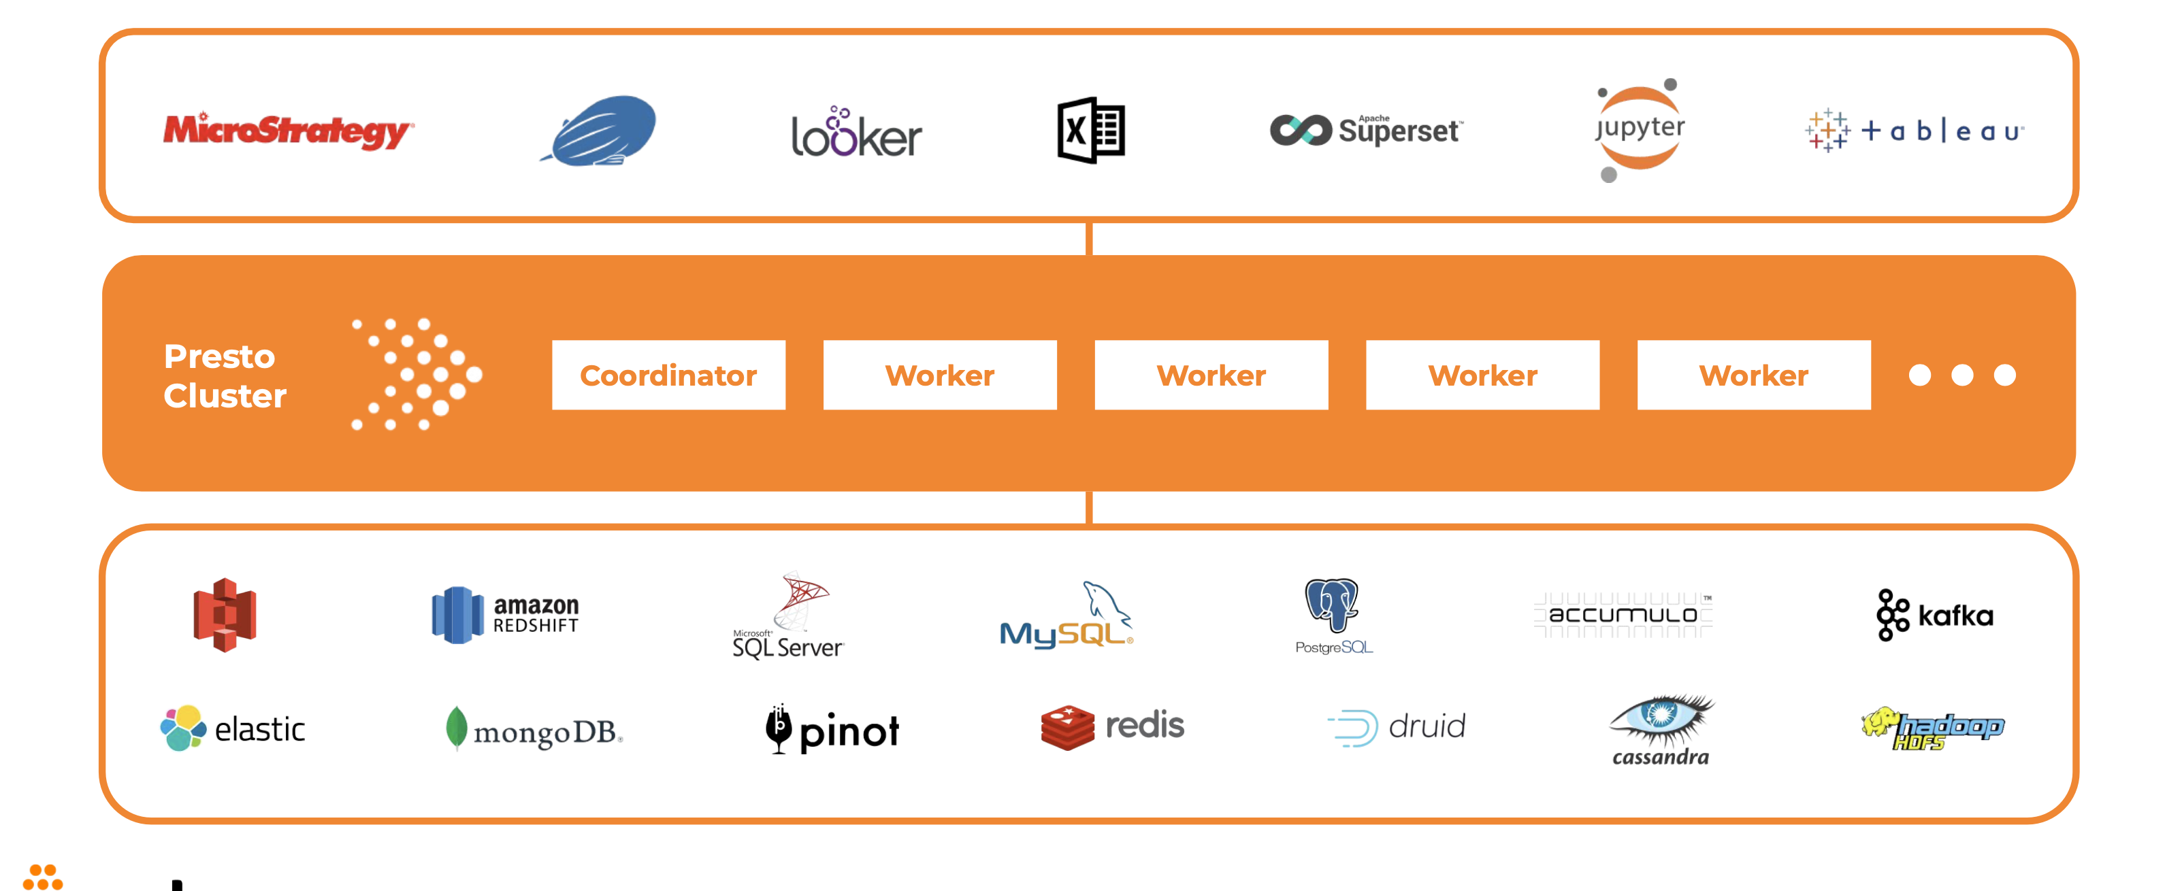

Presto Overview

Slide 6
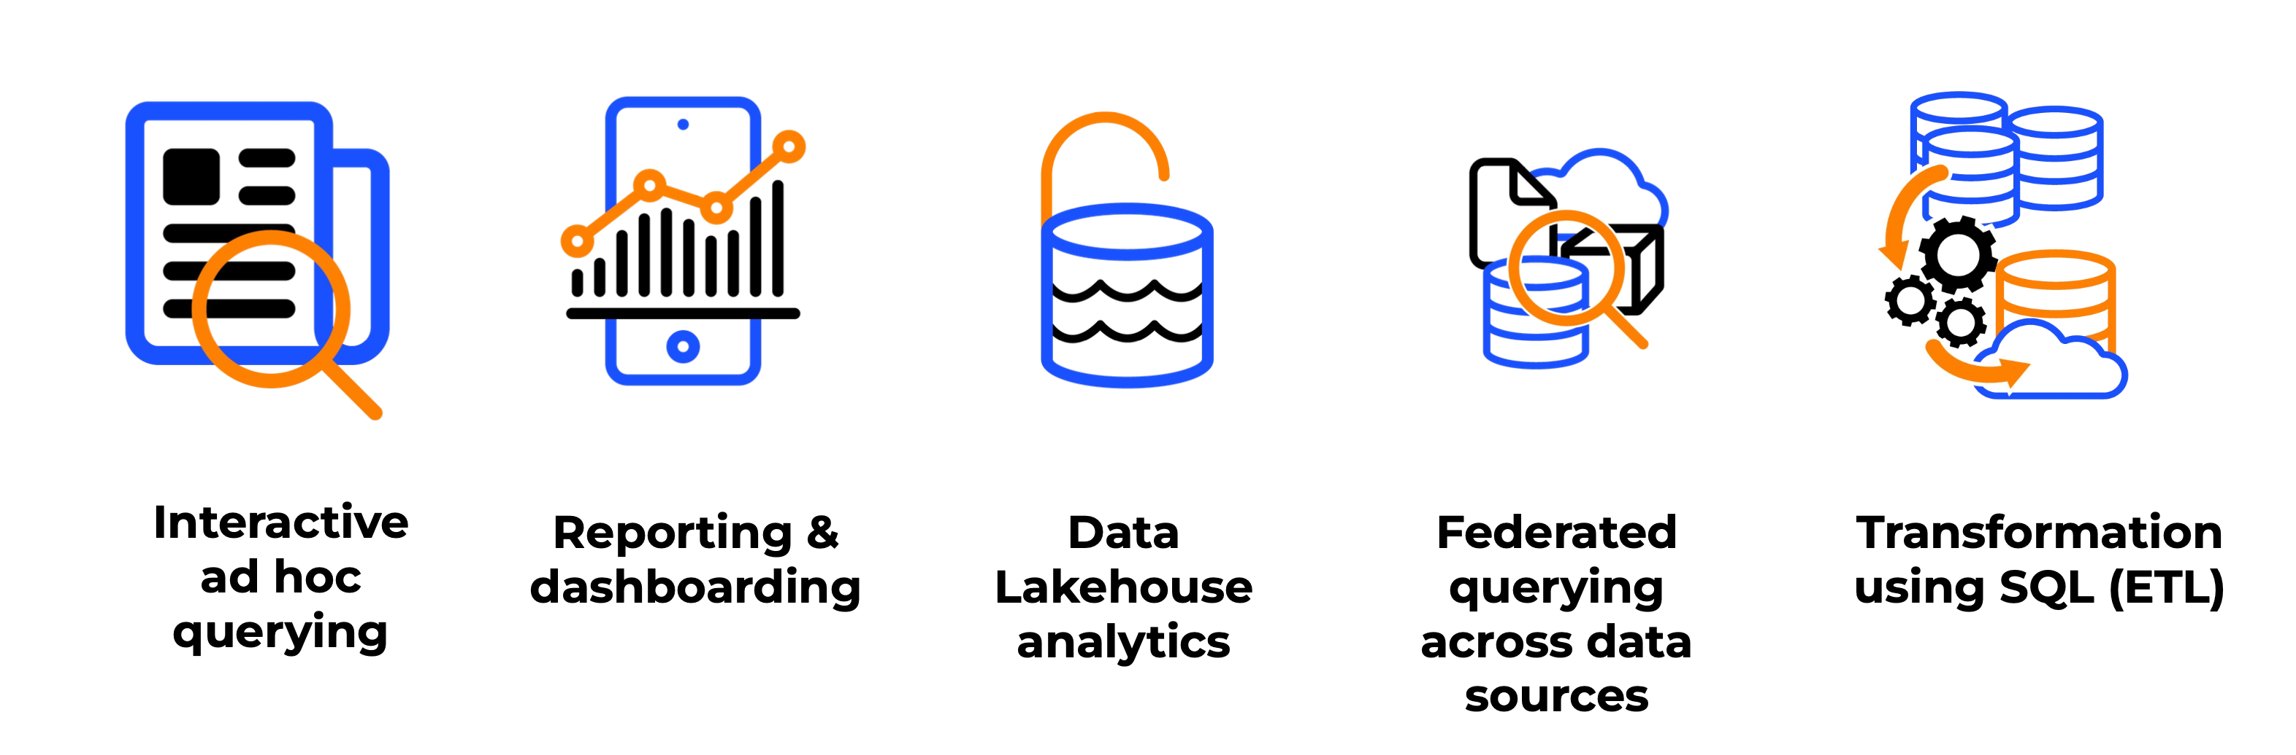
Presto Use Cases

Slide 7

How is Presto different?

Slide 8
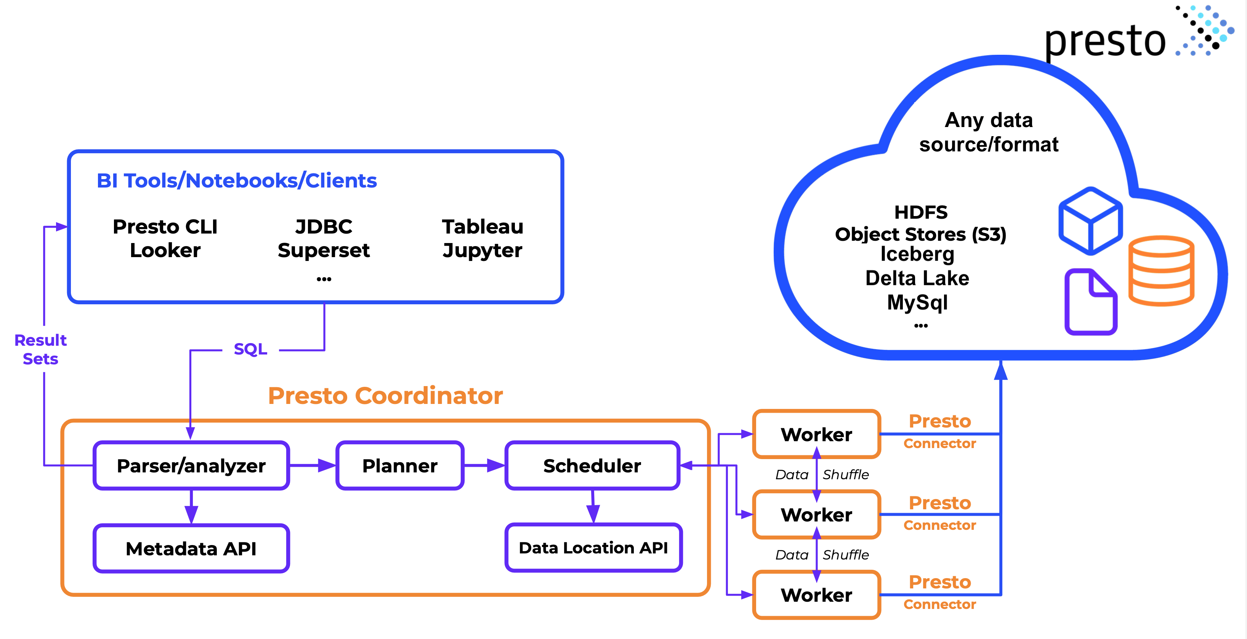
Scalable Architecture
ICBERG
Notes:
Two roles- Coordinator and Worker.
Easily scale up and down.
Scale up to 1000 workers
Validated at web scale companies.

Slide 9
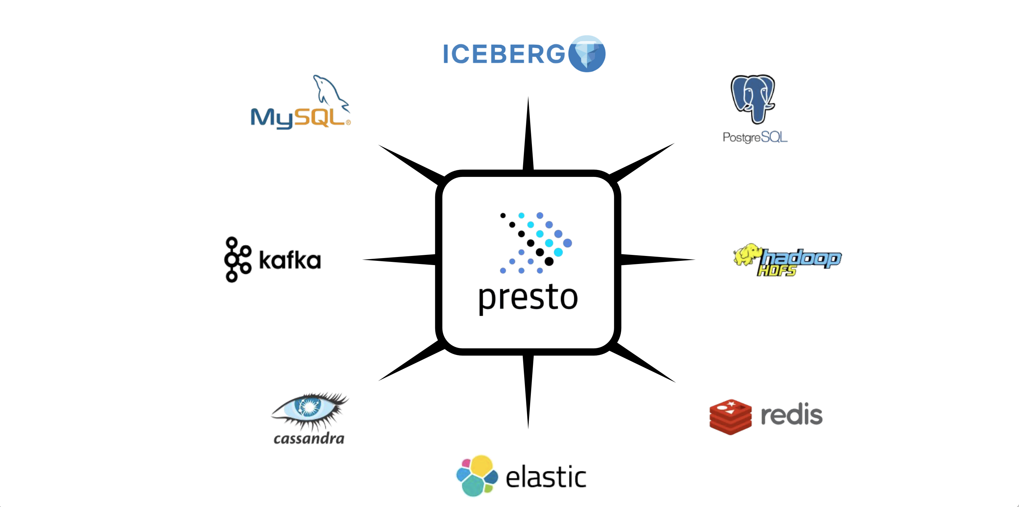
Pluggable Connectors

Slide 10
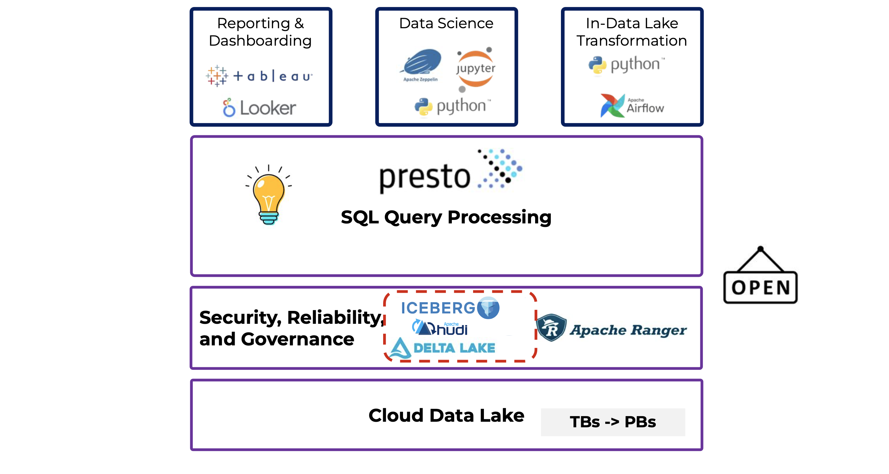
Open Data LakeHouse

Slide 11
Iceberg
Table format specification: How to manage all data in a table over time?
Row level updates: INSERT, DELETE, UPDATE, MERGE
ACID Compliance
Schema evolution and time travel

Slide 12

Getting Started with Presto (Run Presto Anywhere)
https://prestodb.io/docs/current/installation.html

Slide 13












Giants using Presto

Slide 14
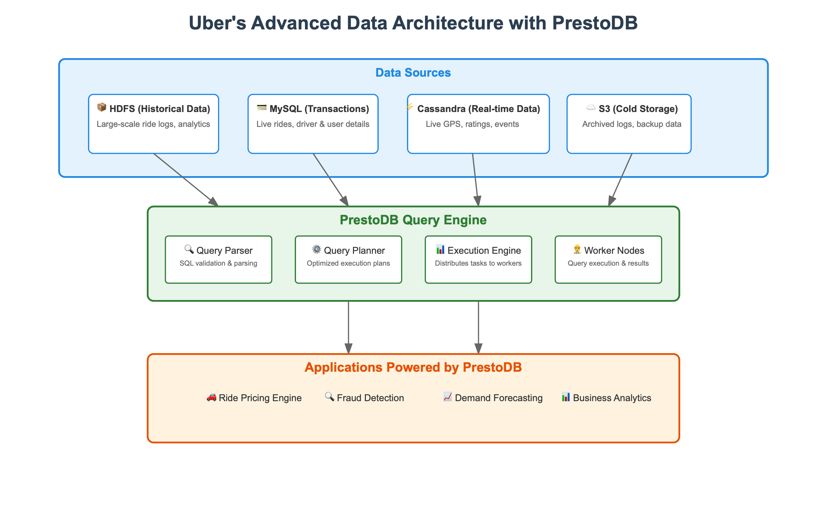
Presto in the Real World (Case Study)

Slide 15
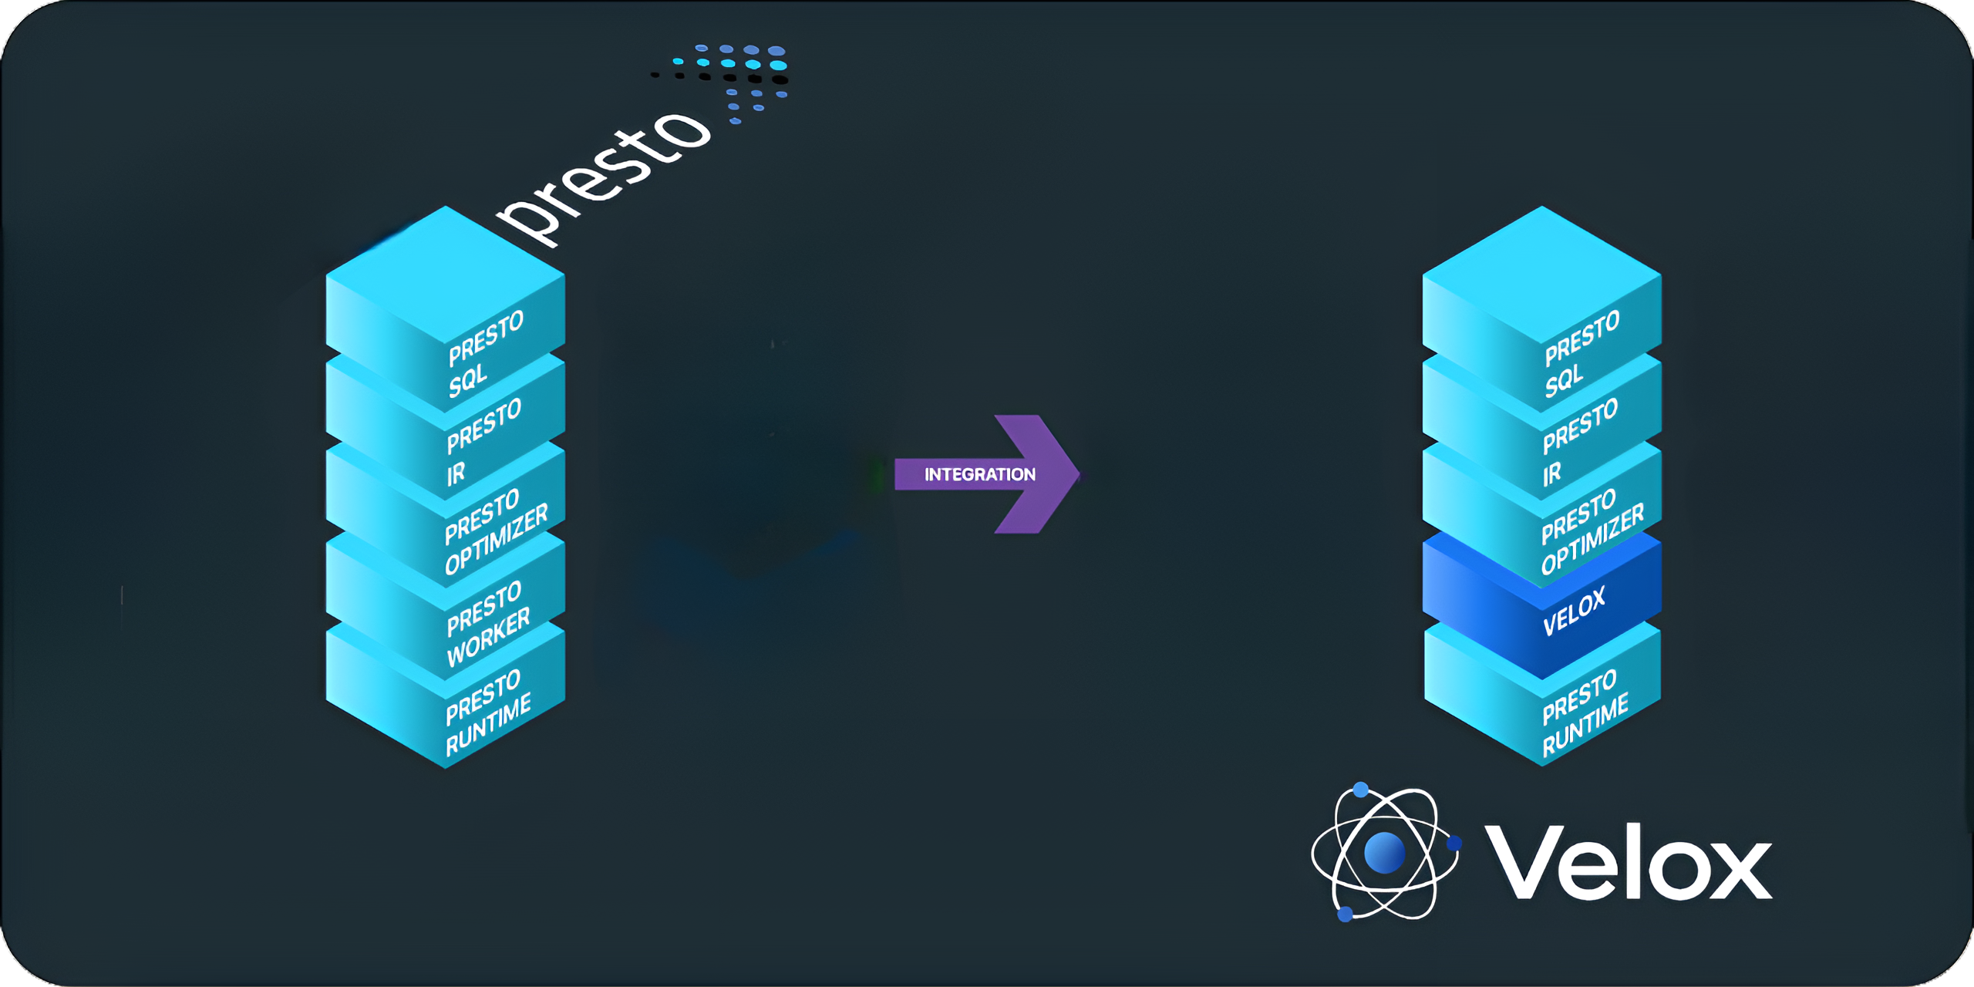
(Presto C++)
Presto C++ is a full re-write of the Presto worker in C++
Drop-in replacement for Presto Java worker.
Velox has unified execution Engine. Reduces Complexity and improve Performance.
Velox has a full home-grown memory management system with advanced features like memory arbitration.

Slide 16
Presto query execution

Slide 17






Join the community
Follow our Linkedin page https://www.linkedin.com/company/presto-foundation
Join the Slack channel prestodb.slack.com
Contribute to the project
github.com/prestodb
Join the virtual meetup group
meetup.com/prestodb
Contribute to the project
Join our Slack Channel

Slide 18
Thanks

